Slide 1
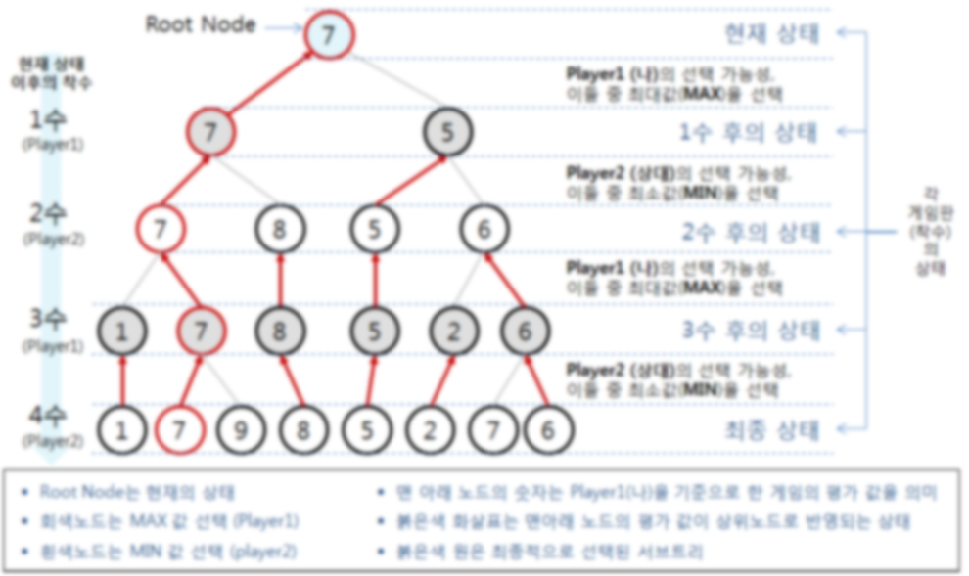
Monte-Carlo Tree Search

Slide 2

MINIMAX

Slide 3
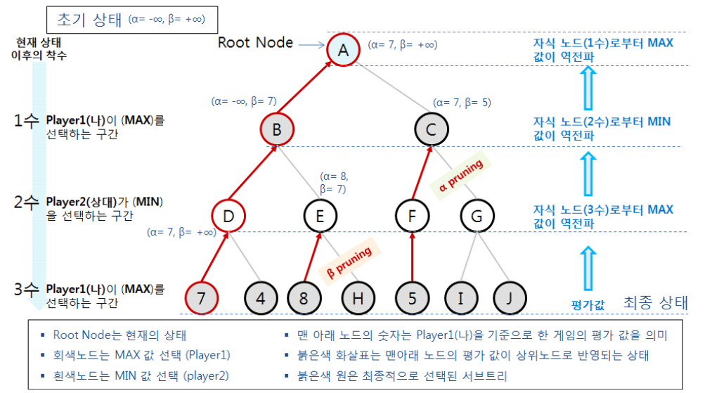
Alpha-Beta Pruning

Slide 4



Upper Confidence Bound (UCB)
In Multi-armed bandit problem,
To maximize expected reward
$$i=argmaxi μi+Pi$$
t = 현재 시간,
ni = i-th arm이 선택된 횟수
MCTS에서, Tree policy로 사용

Slide 5
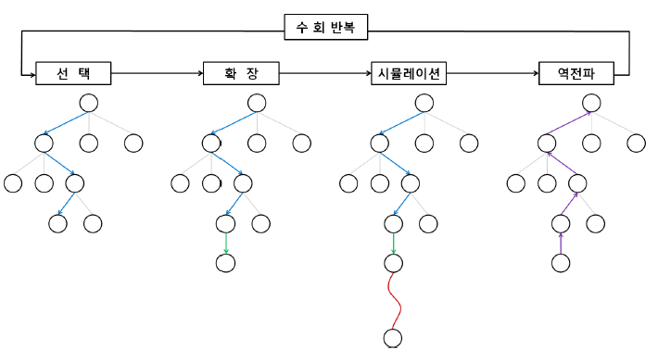
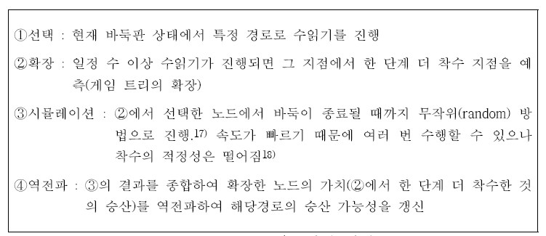
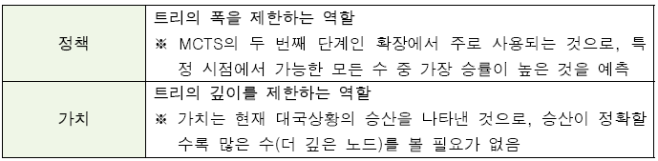
MCTS in AlphaGo

